Slide 1
Light-Weight
Face Detection Challenge
EE boys
吳軍霆 周子庭 陳昱銓

Slide 2
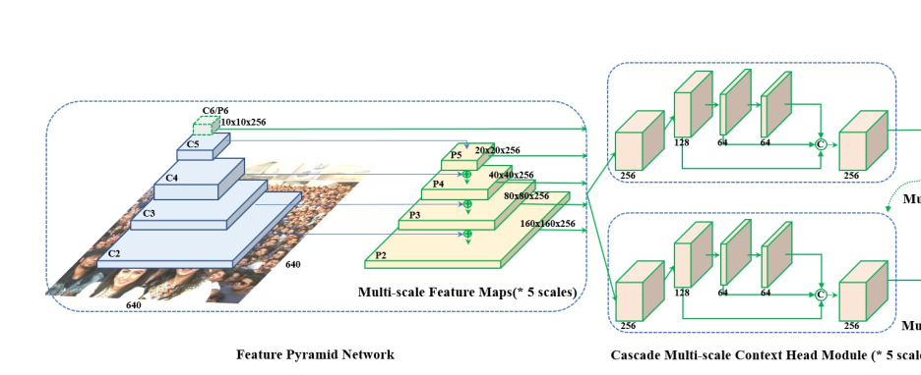
Introduction
Retina-Face
Learn the model design flow of Retina Face.
Context Module
Feature extraction Backbone
Feature Pyramid
Classification
Bbox Regression
Landmark Prediction

Slide 3
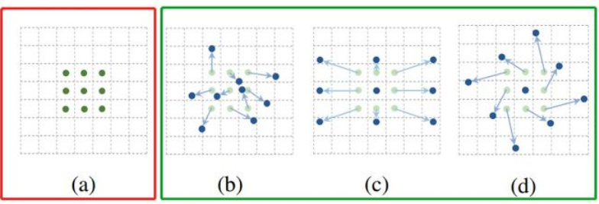
Introduction
Tina-Face
From Tina-face we noticed that using a DCN could improve convolution ability.
Original Convolution
Deformable Convolution

Slide 4
Introduction
EfficientDet
Proposed a different FPN module, called BiFPN.
Which can further strength the ability of cross-scale connections.
F6
F6
F5
F5
F4
F4
F3
F3
F2
F2
FPN
BiFPN

Slide 5
Novelty
Model size constraint:
Because of 5 MB model size constraint, the feature extracor backbone needs to be more effectively and efficiently.
Therefore we introduced several solutions.
5 MB

Slide 6
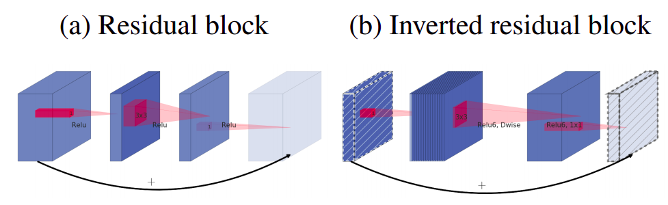
Novelty
Inverted residule module:
Change the feature extraction backbone from mobilenet v1 into mobilenet v2. Simply take the idea of inverted residual.
Prevent data from being lost during convolution downsampling.
We also did an experiment that, we expanded stage number from 3 to 4, we must cut down each stage’s inverted residual number, the result was not better.

Slide 7
Novelty
FPN vs. BiFPN:
We tried both original FPN & BiFPN
By using BiFPN we thought that we could get more informations across different stages and different layers of FPN.
F6
F6
F5
F5
F4
F4
F3
F3
F2
F2
FPN
BiFPN

Slide 8
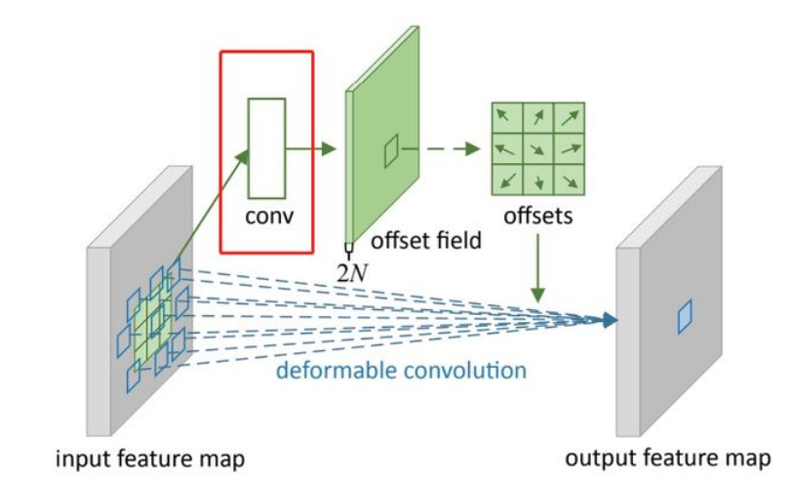
Novelty
DCN layer:
Apply a DCN layer behind the output of Context module.
It works kind of like a weighted layer, focus on the place that really matters.

Slide 9
Model-Architecture
ClassHead
BboxHead
LandmarkHead
Stage 3
FPN
or
BiFPN
SSH
DCN
Stage 2
SSH
DCN
Stage 1
SSH
DCN
Backbone
Multibox loss

Slide 10
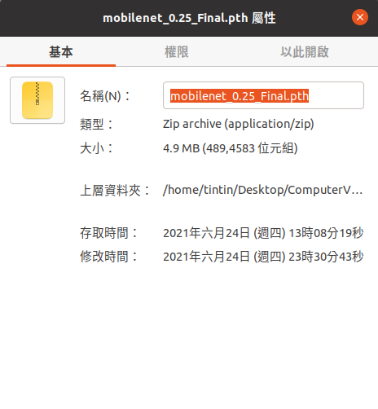
Model-Size
Size : 4.9MB
Try our best to max out 5MB
When trying DCN and BiFPN, backbone size drops

Slide 11

Model-Loss Function
Loss = L_{classification} + α * L_{bbox_regression} + L_{five_landmark_regression}
CrossEntropyLoss
SmoothL1Loss

Slide 12
Experiment
 | Score | NME
Retina-Face | 77.01 | 7.27
inverted residual+FPN+SSH+DCN | 80.77 | 6.373
inverted residual+BifFPN+SSH+DCN | 79.04 | 7.69
inverted residual+FPN+SSH+2*DCN | 80.82 | 6.25
inverted residual+BiFPN+SSH+2*DCN | 80.14 | 7.45

Slide 13
Result
So we conclude that using DCN and FPN is a better choice
Backbone size matters
We choose Inverted Residual,FPN,2 layers DCN as our final model

